Slide 1
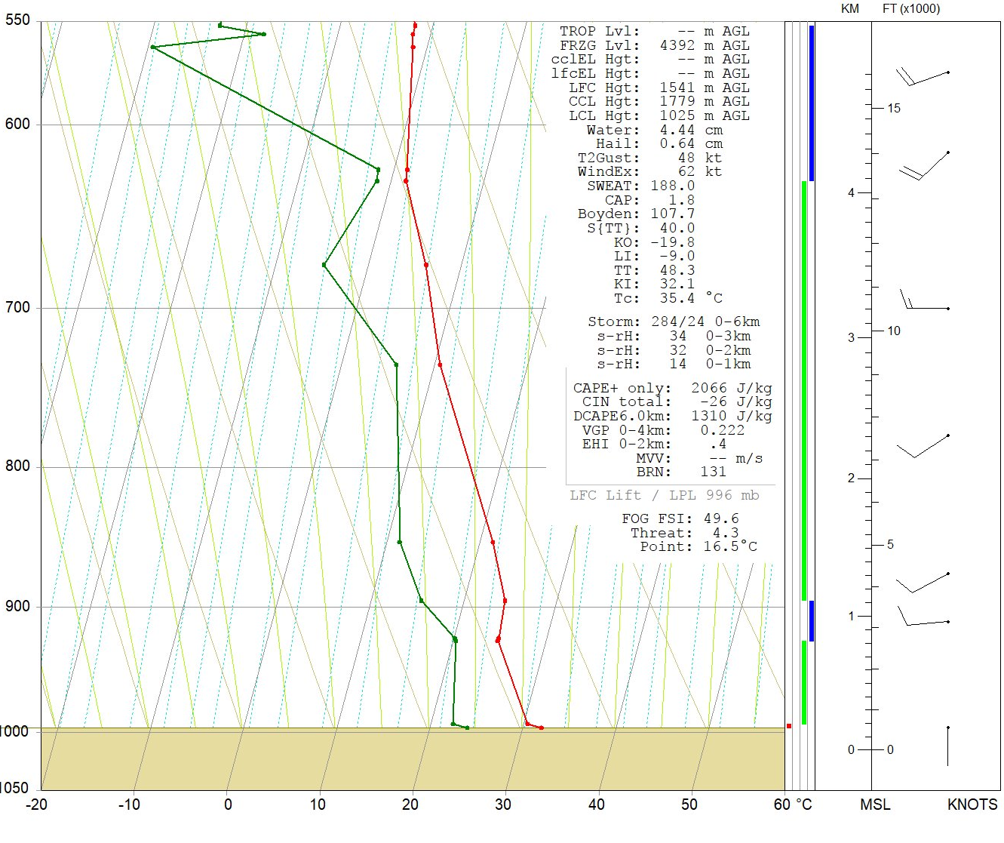
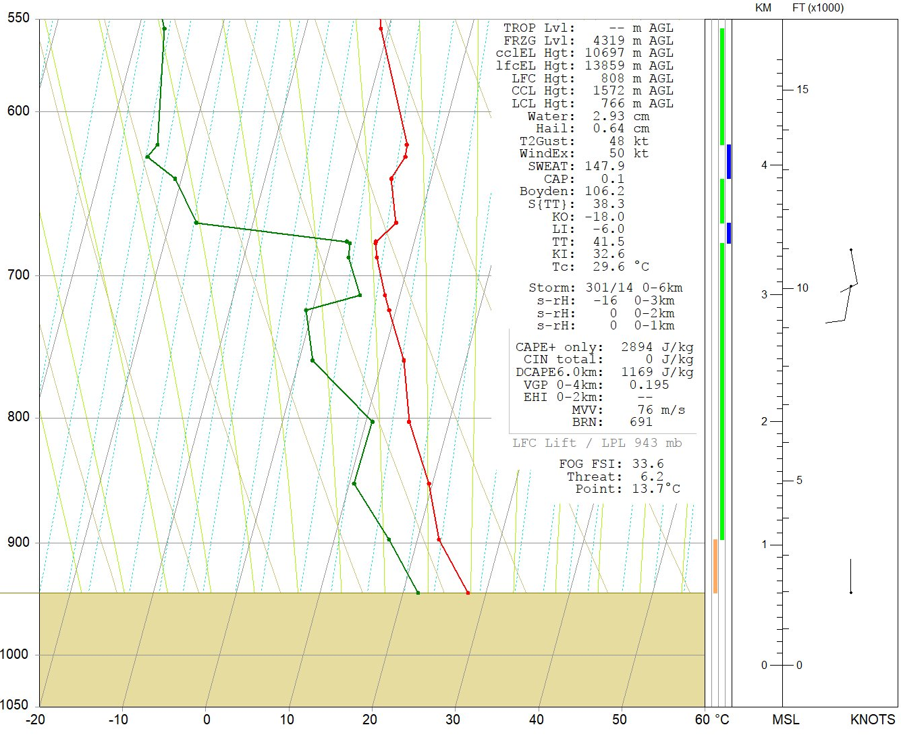
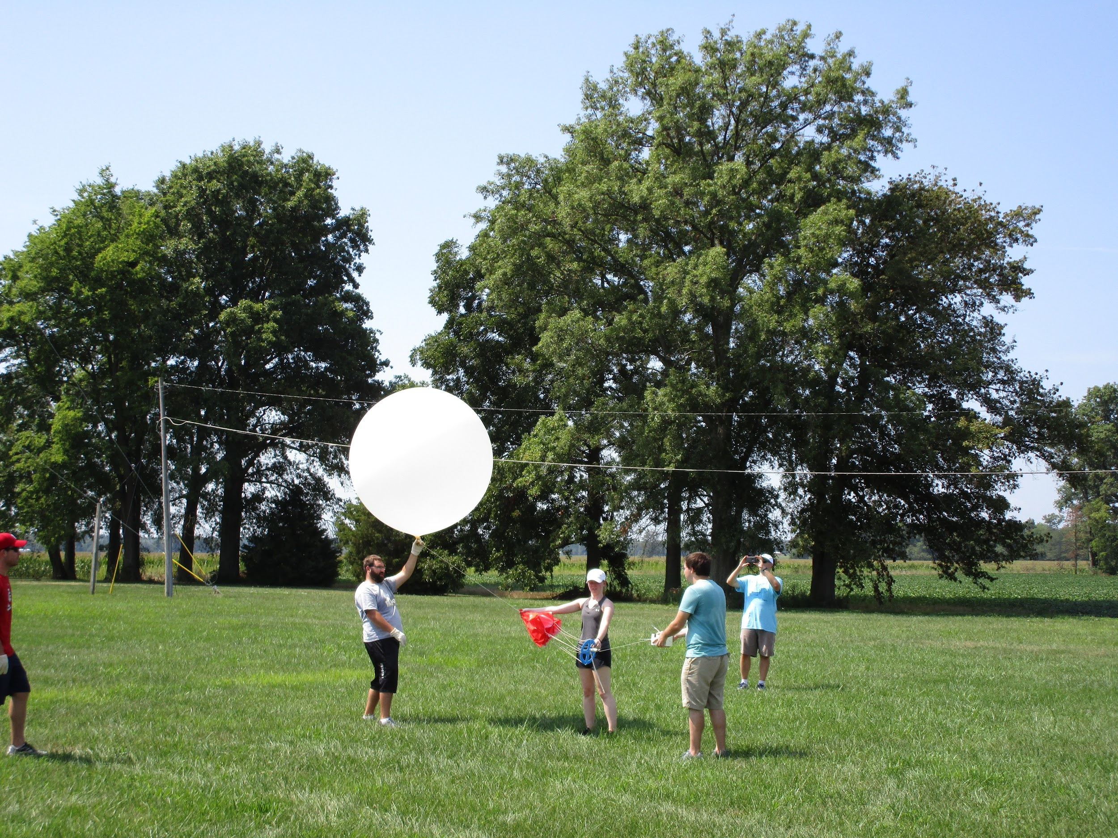
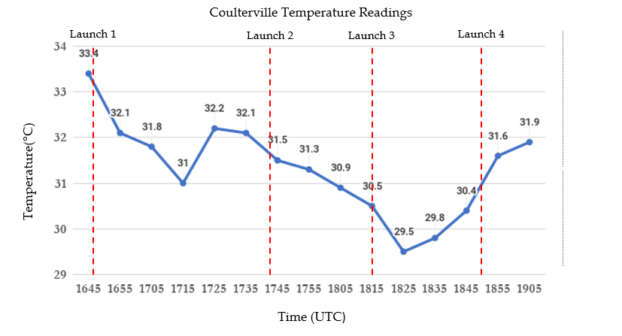
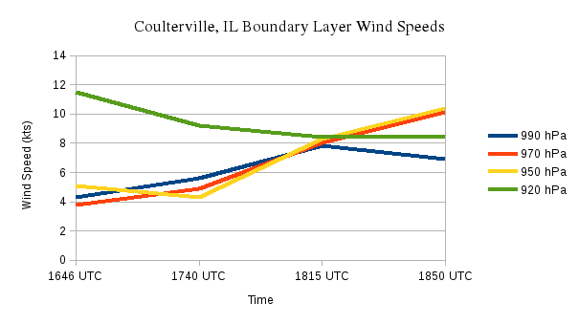
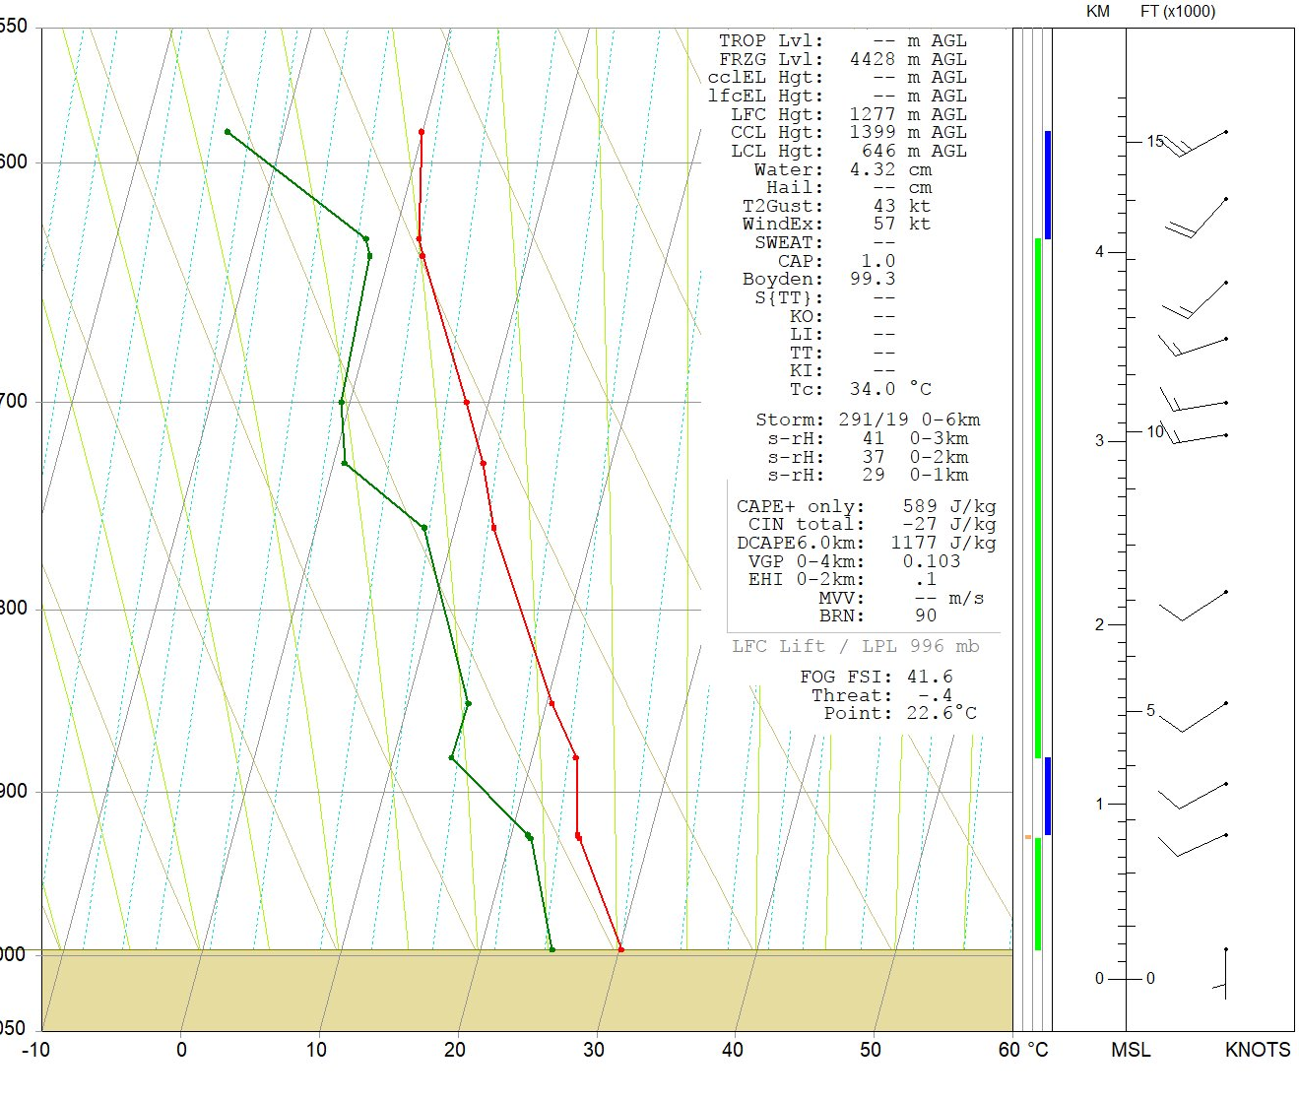
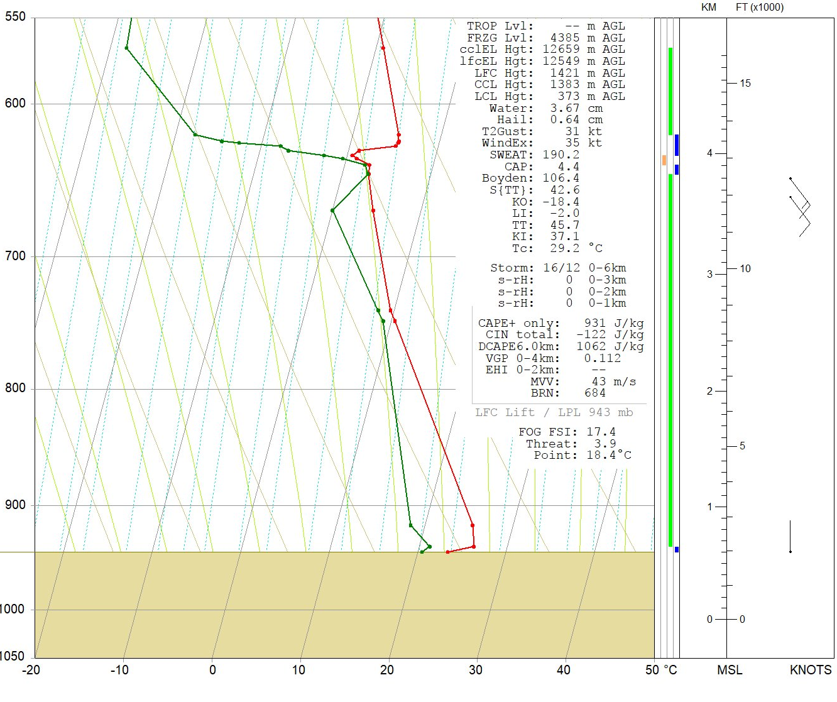
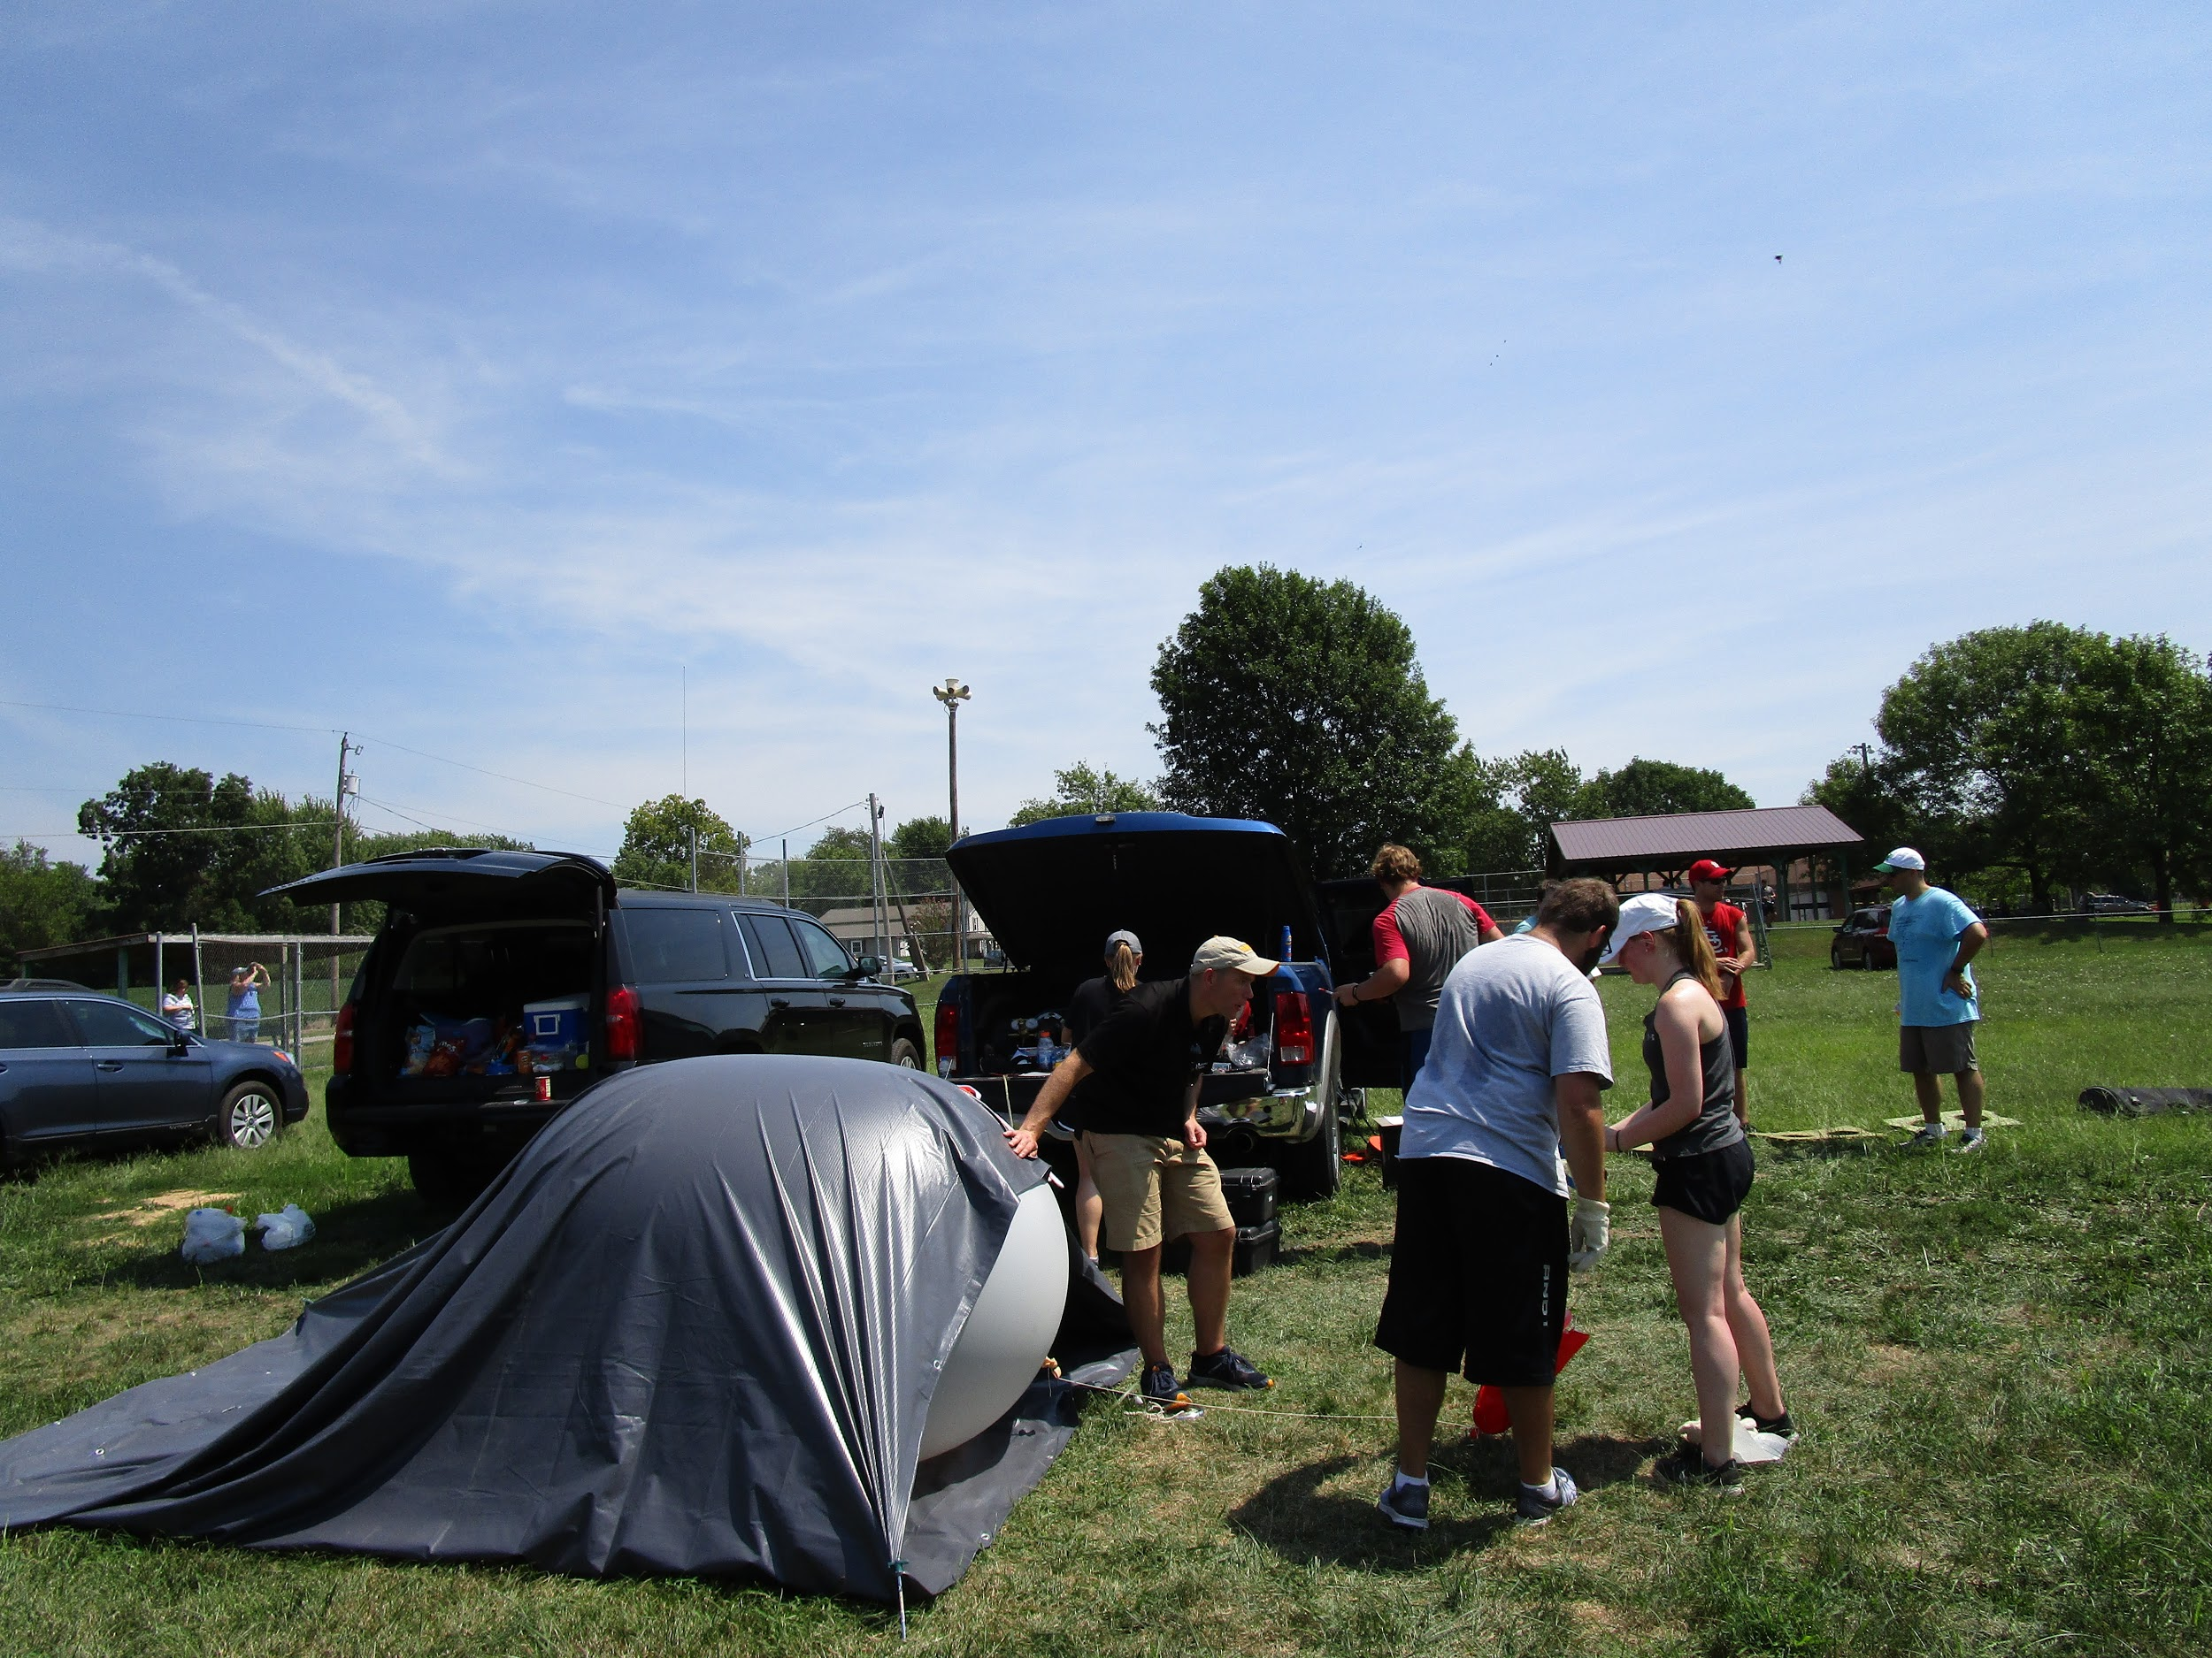
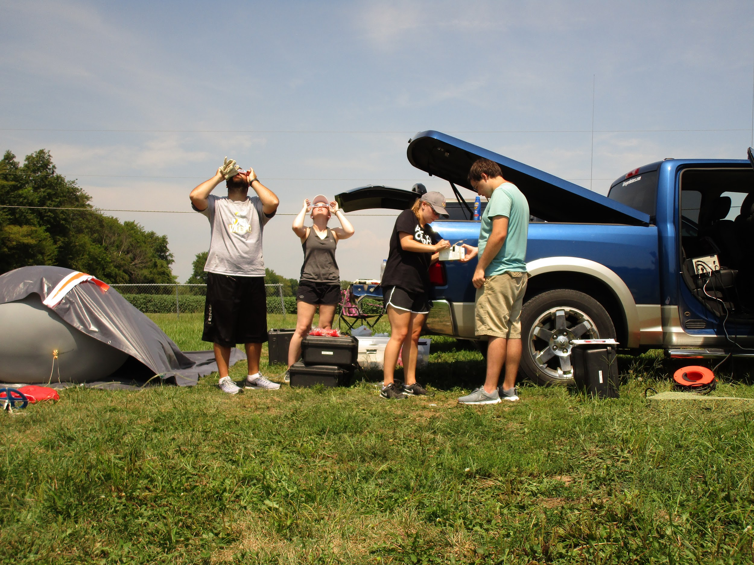
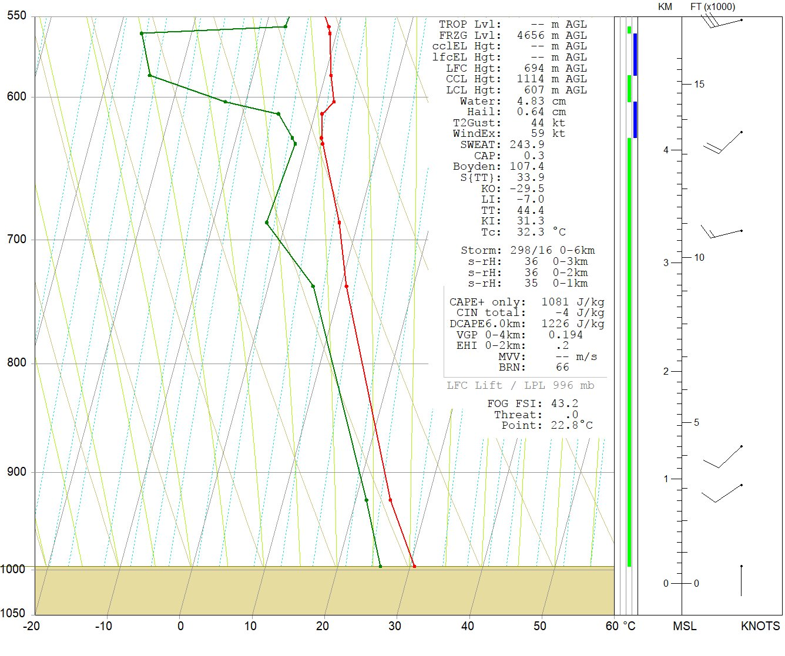
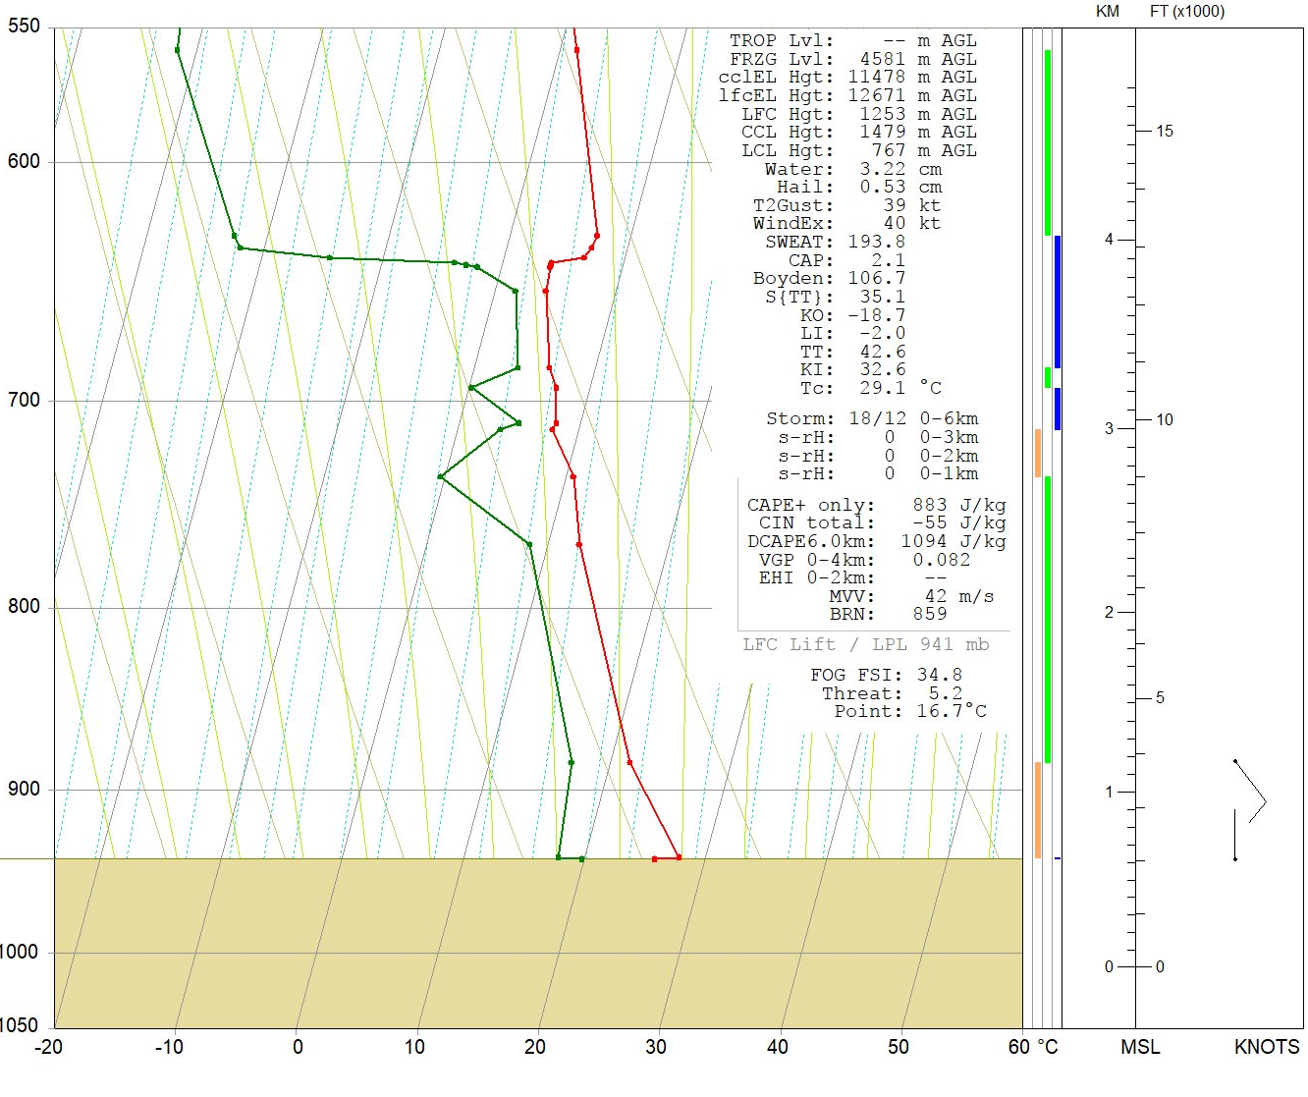
Observations of the Planetary Boundary Layer During the 2017 North American Solar Eclipse
Kristen Axon, Cole Evans, Erika Goshorn, Aaron Mehner, Seth Tacke, and William Wight
Faculty Advisor Dr. Adam Stepanek
Department of Geography and Meteorology, Valparaiso University
Authors
Affiliations
Introduction
Skew-T Analaysis From Radiosonde Launches
Temperature Table and Time Series Plot
On August 21, 2017, the United States experienced a total solar eclipse. This event provided a unique opportunity to study an eclipse’s impact on the vertical profile of the atmosphere.
A solar eclipse is hypothesized to be associated with a drop in temperature, moisture changes, and variability with wind speed.
During the solar eclipse, radiosondes were launched into the atmosphere to collect data on atmospheric parameters including temperature, pressure, and humidity before, during, and after totality.
Coulterville, IL
Otto, NC
Table 1. Temperature changes between radisosonde launches for 950-hPa, 850-hPa, 750-hPa, and 650-hPa
.
Figure 1. Launch 2 (of 4) at 1740 UTC (before eclipse totality)
Figure 4. Launch 1 (of 3) at 1630 UTC (before eclipse totality)
Figure 7. Time series plot of surface temperatures taken every 10 minutes from 11:45 am to 2:05 pm (CDT) using a Kestrel
Figure 8. Time series plot of wind speed at 990, 970, 950, and 920 hPa at each launch
Methodology
A location within the path of totality absent of large obstructions was chosen to perform the instrumented balloon launches.
Four radiosondes were launched at 11:46 am, 12:40 pm, 1:15 pm, and 1:50 pm (CDT) from Coulterville, IL., capturing atmospheric profiles throughout the spectrum of totality.
Surface temperatures were recorded every ten minutes throughout the duration of the eclipse, starting five minutes before onset. An additional measurement was taken concurrent with eclipse totality at 1:20 pm.
Parameter analysis was conducted through the creation of Skew-T graphs, a surface temperature time series, a table of upper level temperature changes, and a graph with wind speed changes near the surface.
Data collected by Valparaiso University was compared with radiosonde launches performed at the Coweeta Hydrologic Laboratory in Otto, NC.
Methodology
Figure 2. Launch 3 (of 4) at 1815 UTC (five minutes prior to totality)
Figure 5. Launch 2 (of 3) at 1830 UTC (six minutes prior to totality)
Results and Conclusions
Results and conclusions
Notable drop in surface temperatures in conjunction with increasing percentage of solar coverage. Local temporal minimum temperature lagged eclipse totality by approximately five minutes.
Minor increase in near-surface dew point observed concurrent with temperature decrease.
Otto, NC observed a slight decrease in both temperature and dew point while temperatures decreased during totality (with a subsequent increase in the final launch).
General increase in wind speeds in the lowest-levels of the atmosphere evident.
Acknowledgements:
Figure 3. Launch 4 (of 4) at 1850 UTC (30 minutes post totality)
Figure 6. Launch 3 (of 3) at 2030 UTC (55 minutes post totality)
FFFFFFFF
Photos by Dr. Teresa Bals-Elsholz; Comparison soundings from the Coweeta Hydrologic Laboratory; Funding assistance by the Valparaiso University Committee to Enhance Learning and Teaching (CELT)
Acknowledgment:
Photo by Erika Goshorn

